Slide 1


Power Consumption Measuring and Controlling Tool
Information & Communication Technology

Slide 2
Our Team
G.D.H.P Gamage ICT/08/09/002 2279
J.P.H.V Jayasinghe ICT/08/09/011 2283
H.M.V.C.I Bandara ICT/08/09/054 2271
S.S Thiyambarawatta ICT/08/09/023 2309
M.K.S. Nisrina ICT/08/09/036 2294
M.A.K.D Fernando ICT/08/09/049 2277

Slide 3

Introduction
We are developing a power monitoring and controlling system. We have finished our documentation part and now we are stepping through the development of the system.

Slide 4
Up to now we have implemented 2 use cases
Log In
Create Users

Slide 5
Progress of power man
Web pages Created
Log in form
Home page
Create user form
Steps for user confirmation
Create user form is validated using jQuery
Database is also created

Slide 6
Special feature
We use responsive design to our web pages
What is responsive?sign?
Responsive web design is the approach that the design and development should respond to the users’ behavior and environment based on screen size, platform and orientation

Slide 7
Why responsive design?
Day by day, the number of devices, plat forms and browsers are growing
As the user switches from their laptop to iPad, it is convenient when the website automatically switches the resolution, image size and scripting abilities according to that platform
This can be done using CSS media query

Slide 8
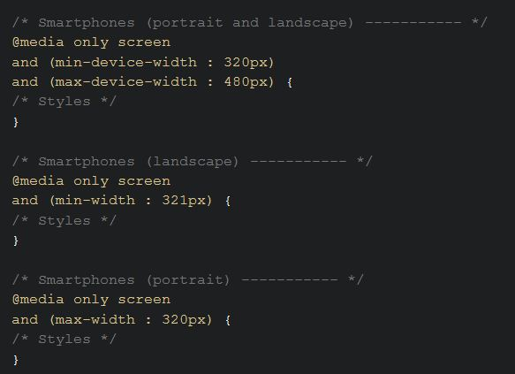
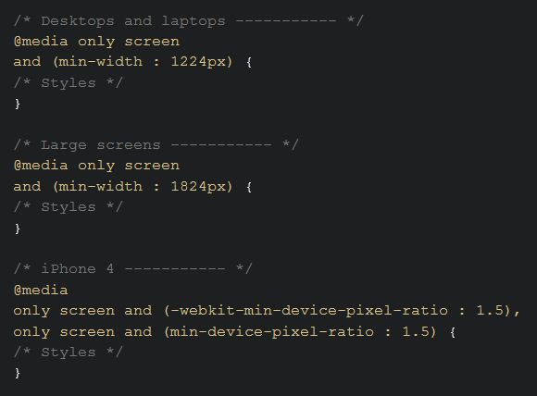
Media queries
Media queries support our responsive designing. We can define standard device sizes using media queries

Slide 9
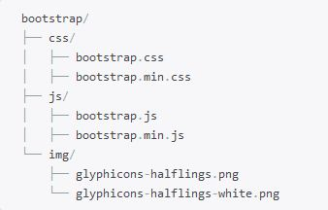
Bootstrap framework
We use bootstrap to do this responsive design
This frame work gives us the file structure which required to responsive design

Slide 10
Codeignator framework
CodeIgniter is an Application Development Framework
a toolkit for building web sites using PHP

Slide 11
Innovative features
In enterprise version, suggesting to shift for a generator when user exceeds the defined power level
If there is an emergency situation occurred, the user quickly receives SMS to his mobile phone without loging on to the system

Slide 12
Keep track of the power consumption of each device for a 3 month and predicting the next electricity bill
Give suggestions using market’s currently available low power consuming equipment
Give suggestions to manage and change the position of the equipment as an optimal way

Slide 13
Demostration
Visit Our Site
Responsive Check

Slide 14
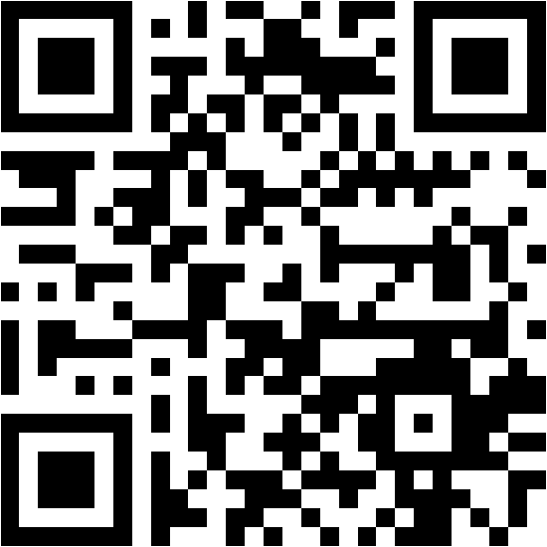
Use your phone to visit our site

Slide 15
Thank You

